Slide 1
Farming Assistant Web Service
Done by;
Meghavarshine K.S
Mirudula laxmi T

Slide 2
INTRODUCTION
A web project to help farmers ensure greater profitability through direct farmer to buyer and supplier. This service boosts business communication and brings transparency in the system.

Slide 3
OBJECTIVES OF THE PROJECT
The specific objective of the project includes:
To provide qualitative foods to the buyers.
Implementing an automated/online agriculture system
To inspire farmer to produce quality products and supply to the buyers
Eco-friendly farming system.

Slide 4
SCOPE OF THE PROJECT
It is focused on studying the existing system of agroculture in and to make sure that the peoples are getting quality fresh goods. This is also will produce:
Less effort and less labor intensive, as the primary cost and focus primary on creating, managing, and running a secure quality food supply.
Increasing number of buyers as individuals will find it easier and more convenient to buy goods.
Easy management.

Slide 5
HARDWARE AND SOFTWARE RESOURCE REQUIREMENTS
SOFTWARE REQUIREMENT
XAMPP
APACHE
MySQLServer
Web Browsers
Windows 7/Higher
HARDWARE REQUIREMENT
Processor – i3 or high
Hard Disk – 5 GB
Memory – 1GB RAM

Slide 6
STAKEHOLDERS FOR THE SYSTEM
Admin
Administrates the system.
Maintain the database.
Rectifies bugs on the system.
Farming Tips
Farmer
Farming Tips / Blog
Crop Advertisement Details
Sell Crop
Sell Crop Details
Edit Farmer Detail
Update Crop Details
Buy Products

Slide 7
STAKEHOLDERS FOR THE SYSTEM (1)
Buyer Supplier
Buyer Details
Crop Received
Edit Buyer Details
Blog
Buy Crop

Slide 8
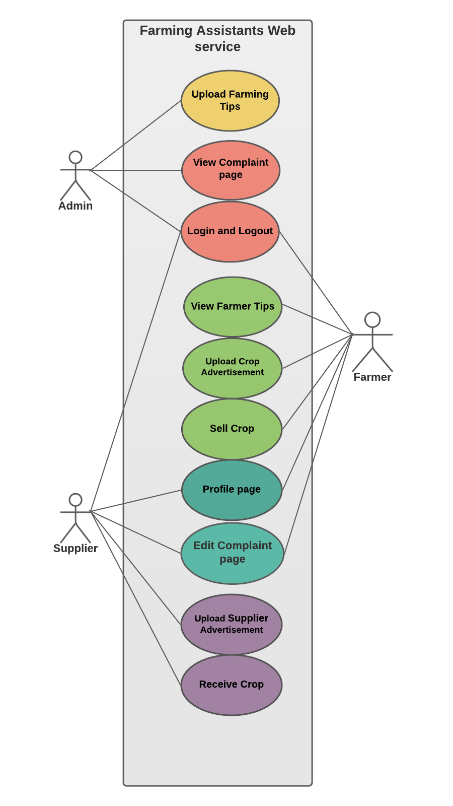
USE CASE DIAGRAM

Slide 9
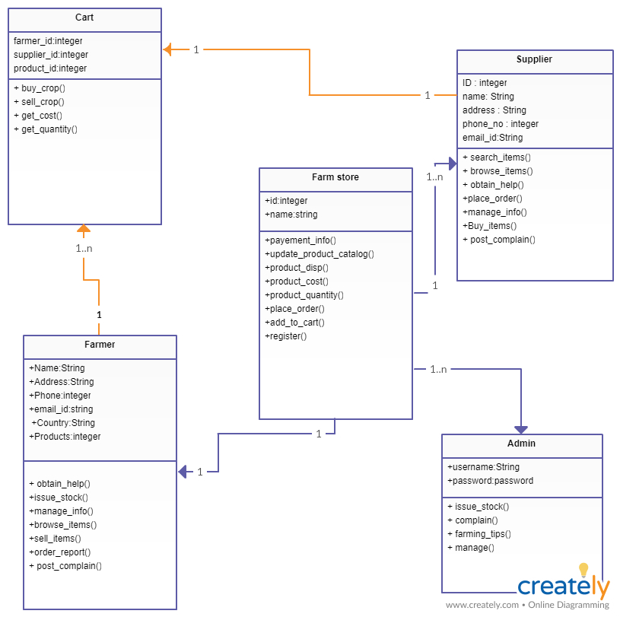
CLASS DIAGRAM

Slide 10
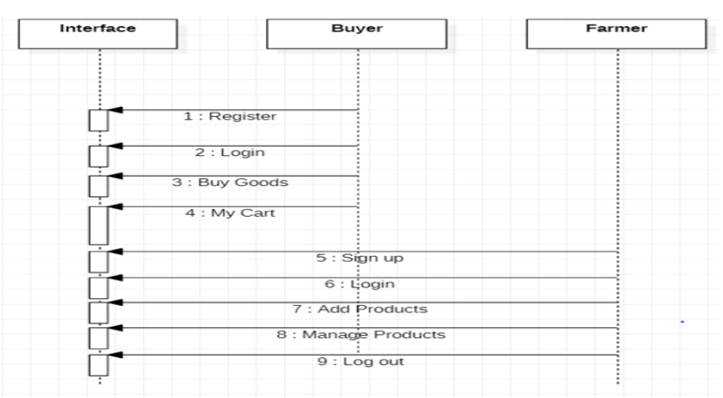
SEQUENCE DIAGRAM

Slide 11
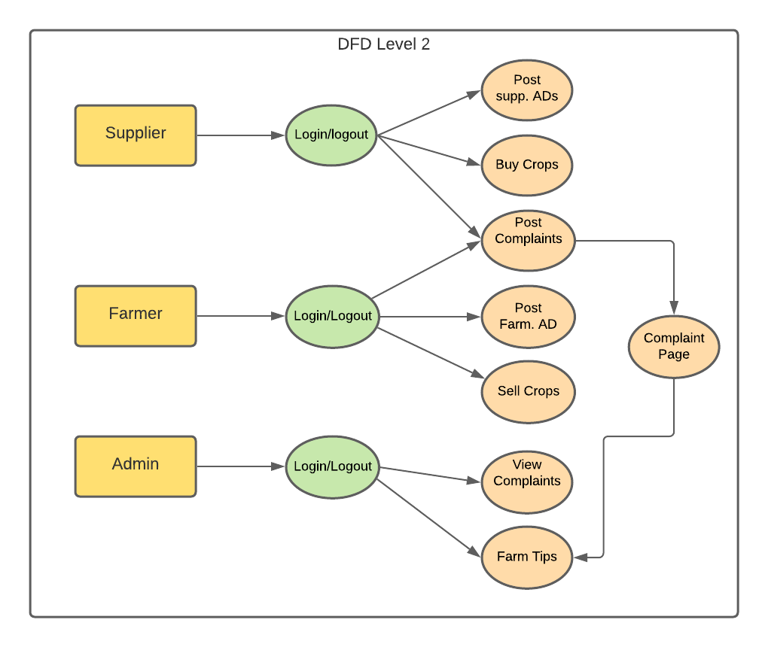
DATA FLOW DIAGRAM

Slide 12
Thank you

